Slide 1



Sikuli
Ivailo Dinkov
QA Engineer
PhoneX Team
Telerik QA Academy

Slide 2
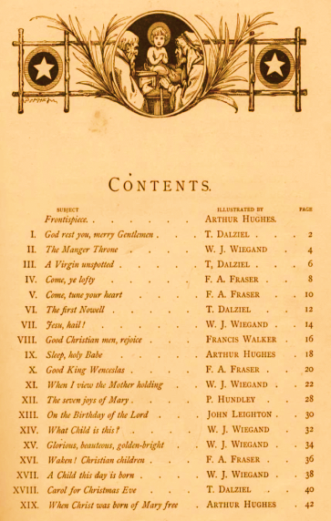


Table of Contents
What is Capture/Replay tool
Issues to solve
Introducing Sikuli
Sikuli Script
The Structure of Test Folder
Platform Independence

Slide 3

Table of Contents (1)
What we need
How Sikuli Works
Using Sikuli IDE
HTMLTestRunner
Advantages
Limitation

Slide 4

What is Capture/Replay tool
The test developer interacts with an application under test, typically through the graphical user interface (GUI), while some capture tool simultaneously generates an automated test script
Tests are difficult to maintenance as the application changes
ex. screens will get added, buttons will get removed, column names will get modified

Slide 5
Issues to solve
GUIs are difficult to test directly in code
Need of a reliable consistent regression test execution approach
Need of easy-to-read test execution results
Too many repeatable test steps
No suitable tools for specific applications (e.g. mobile app simulators)

Slide 6

Introducing Sikuli
Screenshot driven – it is a visual technology to search and automate GUI using images
Intuitive open-source visual scripting tool
Scripts are written in Python
integrates with jUnit and supports unit testing for GUI
ability to import entire libs or only a selected subset of methods (reuse code and images)

Slide 7


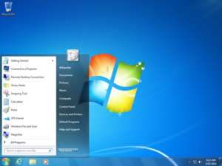
Sikuli Script
Sikuli Script is a Jython and Java library that automates GUI interaction using image patterns to direct keyboard/mouse events

Slide 8

The Structure of Test Folder
Sikuli source/executable script directory (.sikuli)
Python source file (.py)
Images files (.png)
While saving a script using Sikuli IDE, an HTML file is created

Slide 9
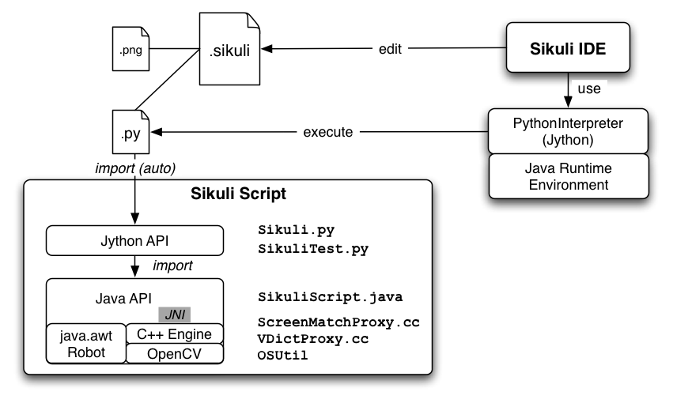
System Design

Slide 10



Platform Independence
Works on any GUI can be displayed on Windows/Linux/Mac
Virtual machines
Remote desktop
Mobile simulators: Android, iPhone
Web: Flash, HTML + Javascript

Slide 11


What we need
Prerequisites for the lecture
Windows OS
Sun Java 6 JRE 32-bit version
Download and install Sikuli
site: http://www.sikuli.org/download.html
Notes:
http://www.sikuli.org/download.html

Slide 12
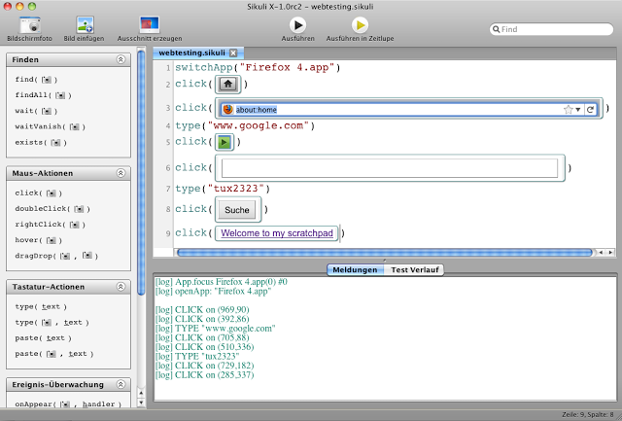
How Sikuli Works
Combination of GUI & Traditional coding
Jython coding that can use images as parameters and variables
Screen Capture utilized for image selection instead of object IDs
Can upload image files

Slide 13
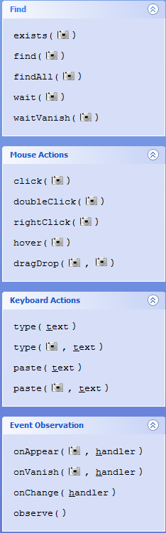
Using Sikuli IDE
Predefined Sikuli Global functions
IDE Command List – exists, find, findAll, wait, click, doubleClick, dragDrop, type
switchApp("App Name")
keyDown(Key.SHIFT+ "a")
keyUp(Key.SHIFT+ "a")
popup("message")
userText=input("msg", "default")

Slide 14
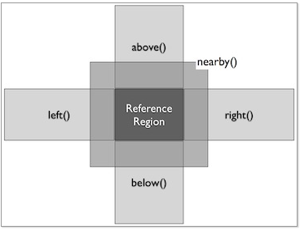
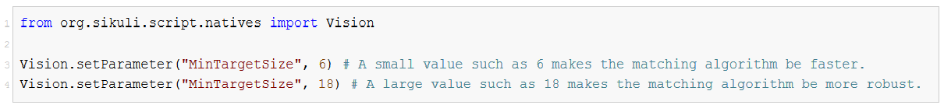
Using Sikuli IDE (2)
Regions – a rectangular area: Region(x, y, w, h)
Finding Regions:
windowRegion = App.focusedWindow()
buttonRegion = find()
Acting with Regions
region.highlight, click, type, find, etc..
Extending Regions
region.offset(x,y)
Tuning the Vision Algorithm

Slide 15
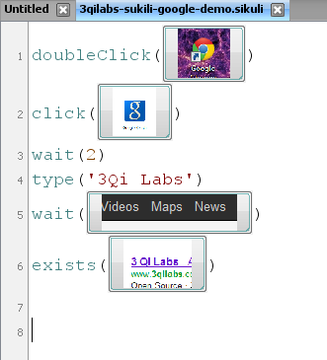
Using Sikuli IDE (3)
Editor for writing Sikuli scripts in Python

Slide 16
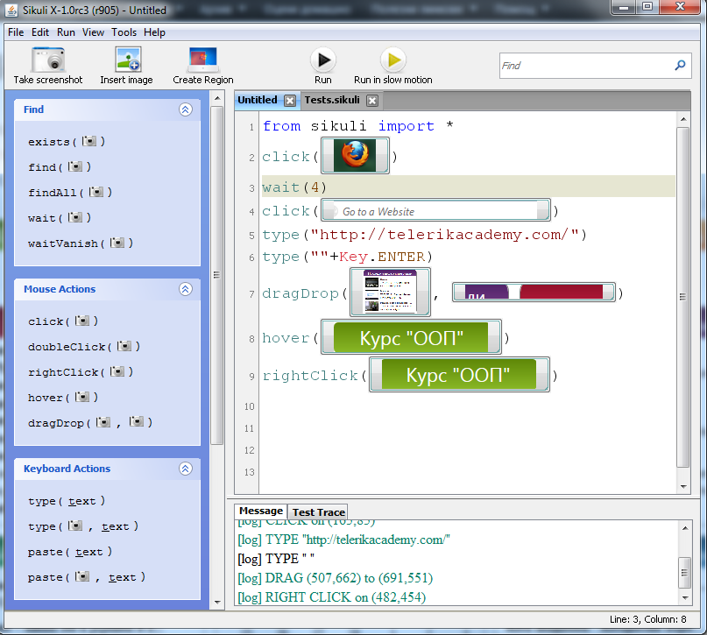
Using Sikuli IDE (4)
The buttons activate the screenshot mode

Slide 17
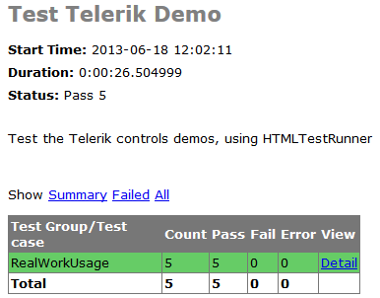
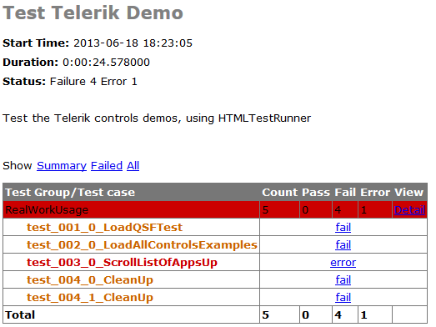
HTMLTestRunner
HTMLTestRunner is an extension to the Python standard library's unittest module
It generates easy to use HTML test reports

Slide 18

Advantages
Allow programmer to make visual references instead of using names or keywords
More intuitive and natural approach
Useful for specific applications that involve manipulation of GUI

Slide 19

Limitation
Sikuli Script operates only in the visible screen space and thus is not applicable to invisible GUI elements
ex. elements hidden underneath other windows, in another tab, or scrolled out of view
Dealing with moving, animated objects was hard

Slide 20
Useful Resources
Sikuli Official site: http://www.sikuli.org/
Sikuli documentation: http://doc.sikuli.org/
Sikuli script help: http://doc.sikuli.org/sikuli-script-index.html
HTMLTestRunner page: http://tungwaiyip.info/software/HTMLTestRunner.html

Slide 21
Sikuli
?
?
?
?
?
Questions?
?
?
?
?
?
?

Slide 22
Exercises
Try to run Windows Phone Emulator and using Application Deployment to deploy the .xap file located in Setup folder

